Slide 1
dbconfig
dbconnection
hashing
Population
area_advice
save_search
dbutils
login
predict
API
=
yes_no_input
main

Slide 2
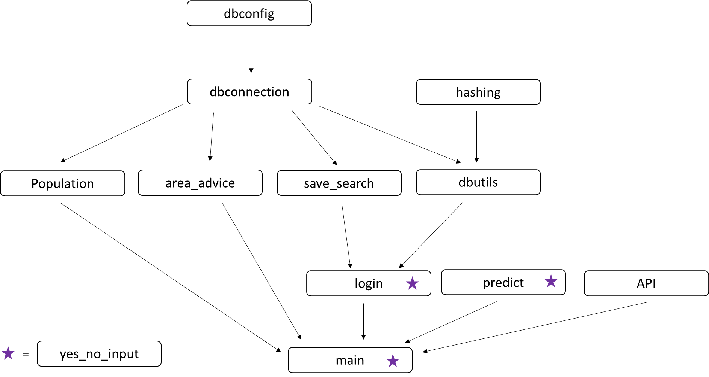

Slide 3
Start
Give MySQL password
User has account?
Create account
Sign-in
Correct?
Correct?
Give Locality/Area name
Correct?
Get COVID-19 risk results
COVID-19 advice?
Get COVID-19 government advice for location
Save search?
Stores search info in SQL database
Stop

